Slide 1
DISTRIBUTED DENIAL OF SERVICE USING MYSQL RELATIONAL DATABASE STRUCTURE BASED ON NETWORK SECURITY

Slide 2
TABLE OF CONTENTS
1
What is The Distributed Denial of Service(DDOS)
2
Example Of DDOS
3
4
how a DDoS attack works
Types of DDoS Attacks
5
Techniques for DDoS Attack
6
Output Of Project

Slide 3

Distributed Denial of Service (DDoS):
Distributed Denial of Service (DDoS) is a type of DOS attack where multiple systems, which are trojan infected, target a particular system which causes a DoS attack.
A DDoS attack is one of the most powerful weapons on the cyber platform
A DDoS attack uses multiple servers and Internet connections to flood the targeted resource
When you come to know about a website being brought down, it generally means it has become a victim of a DDoS attack .

Slide 4

Example of DDOS
In 2008 used the online name “ Mafiaboy ”, was behind one of the first DDoS
He hacked into the computer networks of various different universities.
000, Michael Calce, a 15-year-old boy who He used their servers to operate a DDoS attack that brought down several websites such as eBay and Yahoo.
In 2016, Dyn was hit with a massive DDoS attack that took down major websites and services such as Netflix, PayPal, Amazon, and GitHub

Slide 5
How a DDoS attack works?
Botnet Creation
Traffic Generation
Traffic Flood
System Overload
Attackers create a network of compromised devices (bots) by infecting them with malware
The attacker instructs the bots to send a massive amount of traffic to the targeted system.
The bots overwhelm the targeted system with traffic, making it difficult to handle legitimate requests
The targeted system becomes overwhelmed and unable to function properly.

Slide 6
Implementing Mitigation Strategies
Firewall
Load Balancing
Act as a gatekeeper, filtering and blocking malicious traffic to protect your network.
Distributes traffic across multiple servers, preventing any one server from becoming overloaded.
(IDS/IPS)
CDN
Monitor network activity for suspicious patterns and block threats before they reach your systems.
Deliver content from multiple locations, reducing latency and server load for improved performance.

Slide 7
Techniques Of DDOS Attack
Botnets
Malware
Scripting
Botnets are networks of compromised devices used to launch attacks.
Malware is software designed to
harm or exploit systems.
Scripting is used to automate attack processes.

Slide 8

Why MySQL for DDoS Detection
MySQL can play a crucial role in DDoS attack detection by providing a database infrastructure for storing and analyzing network traffic data. This data can include information about the source and destination of network requests, timestamps, and other relevant metrics.
Here's how MySQL helps in DDoS detection :
Traffic Logging
Anomaly Detection
Alerting and Response
Attack Analysis
MySQL stands out as a preferred choice for DDoS detection due to its proven reliability, scalability, and cost-effectiveness.

Slide 9
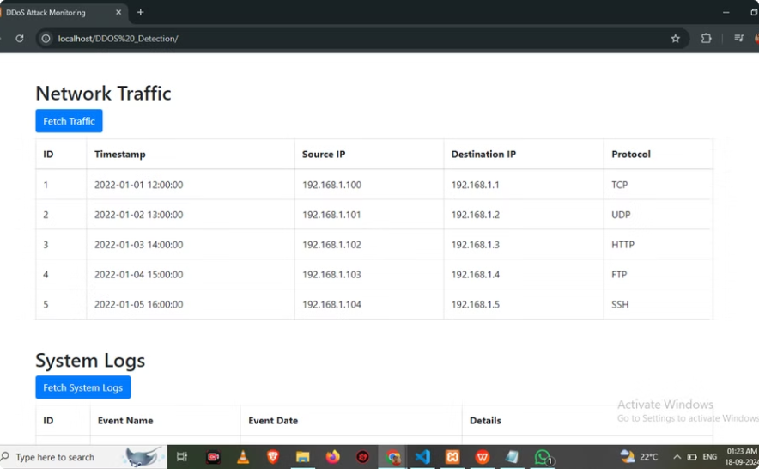
OUTPUT 1

Slide 10
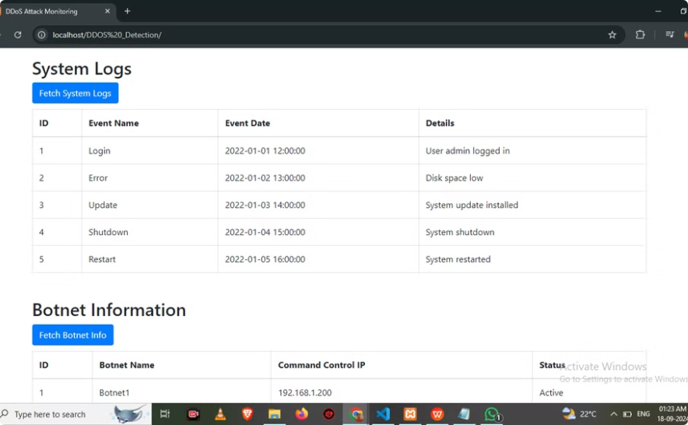
OUTPUT 2

Slide 11
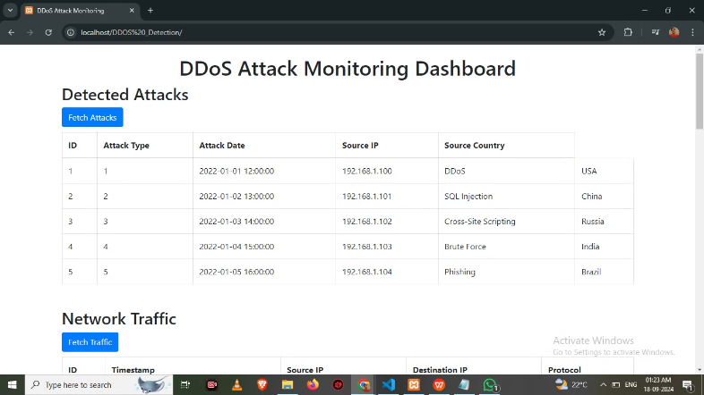
OUTPUT 3

Slide 12
Conclusion
This presentation outlined the key considerations for effective DDoS attack detection, emphasizing the role of MySQL in this crucial process. We explored the various benefits of using MySQL, including its reliability, scalability, and cost-effectiveness, making it a powerful tool for safeguarding networks from malicious attacks.

Slide 13
Thank You !
Does anyone have any questions?

